Slide 1
App Analytics
Or how to spy to your users

Slide 2
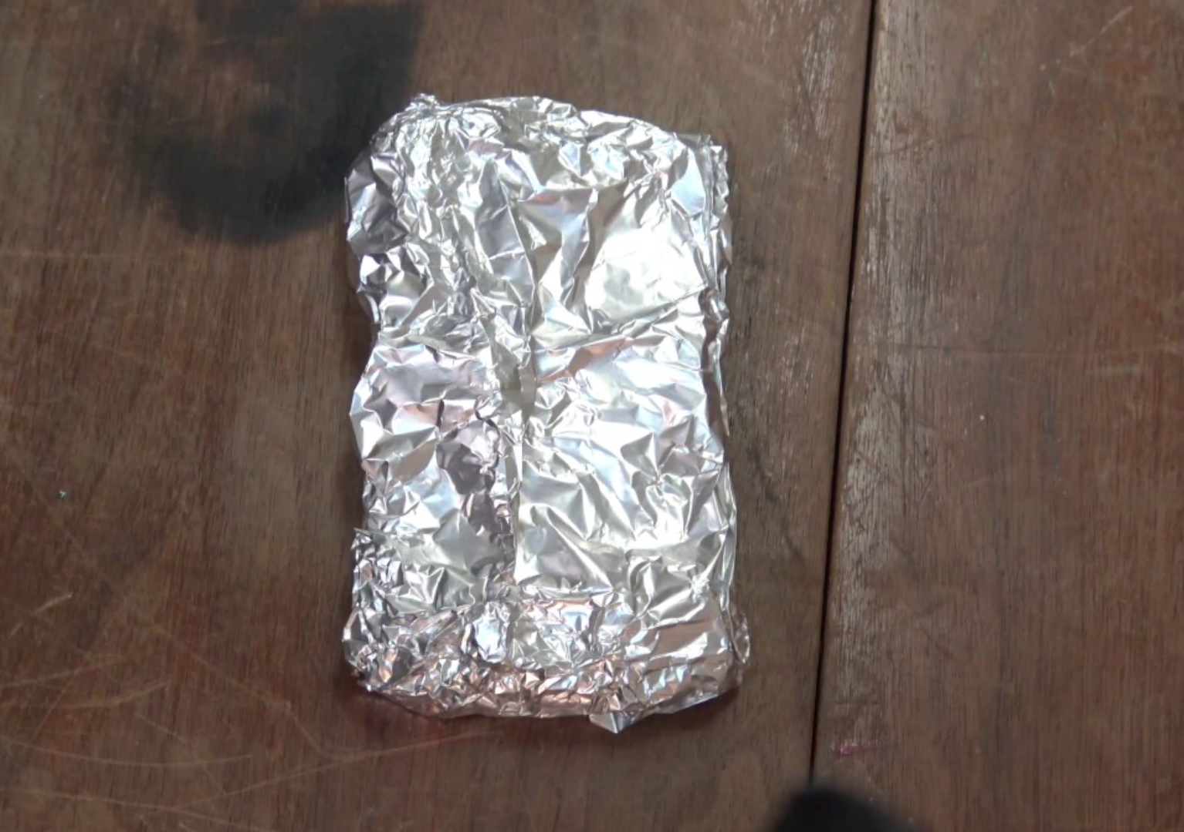
Your phone after today lecture

Slide 3
Benefits of App Analytics
Help you to gather accurate data to better serve your customers
Gives you an overview of your app most used features
Provides you with your best customer portrait
Helps identify growth possibilities

Slide 4
Examples
Google play, no setup needed

Slide 5
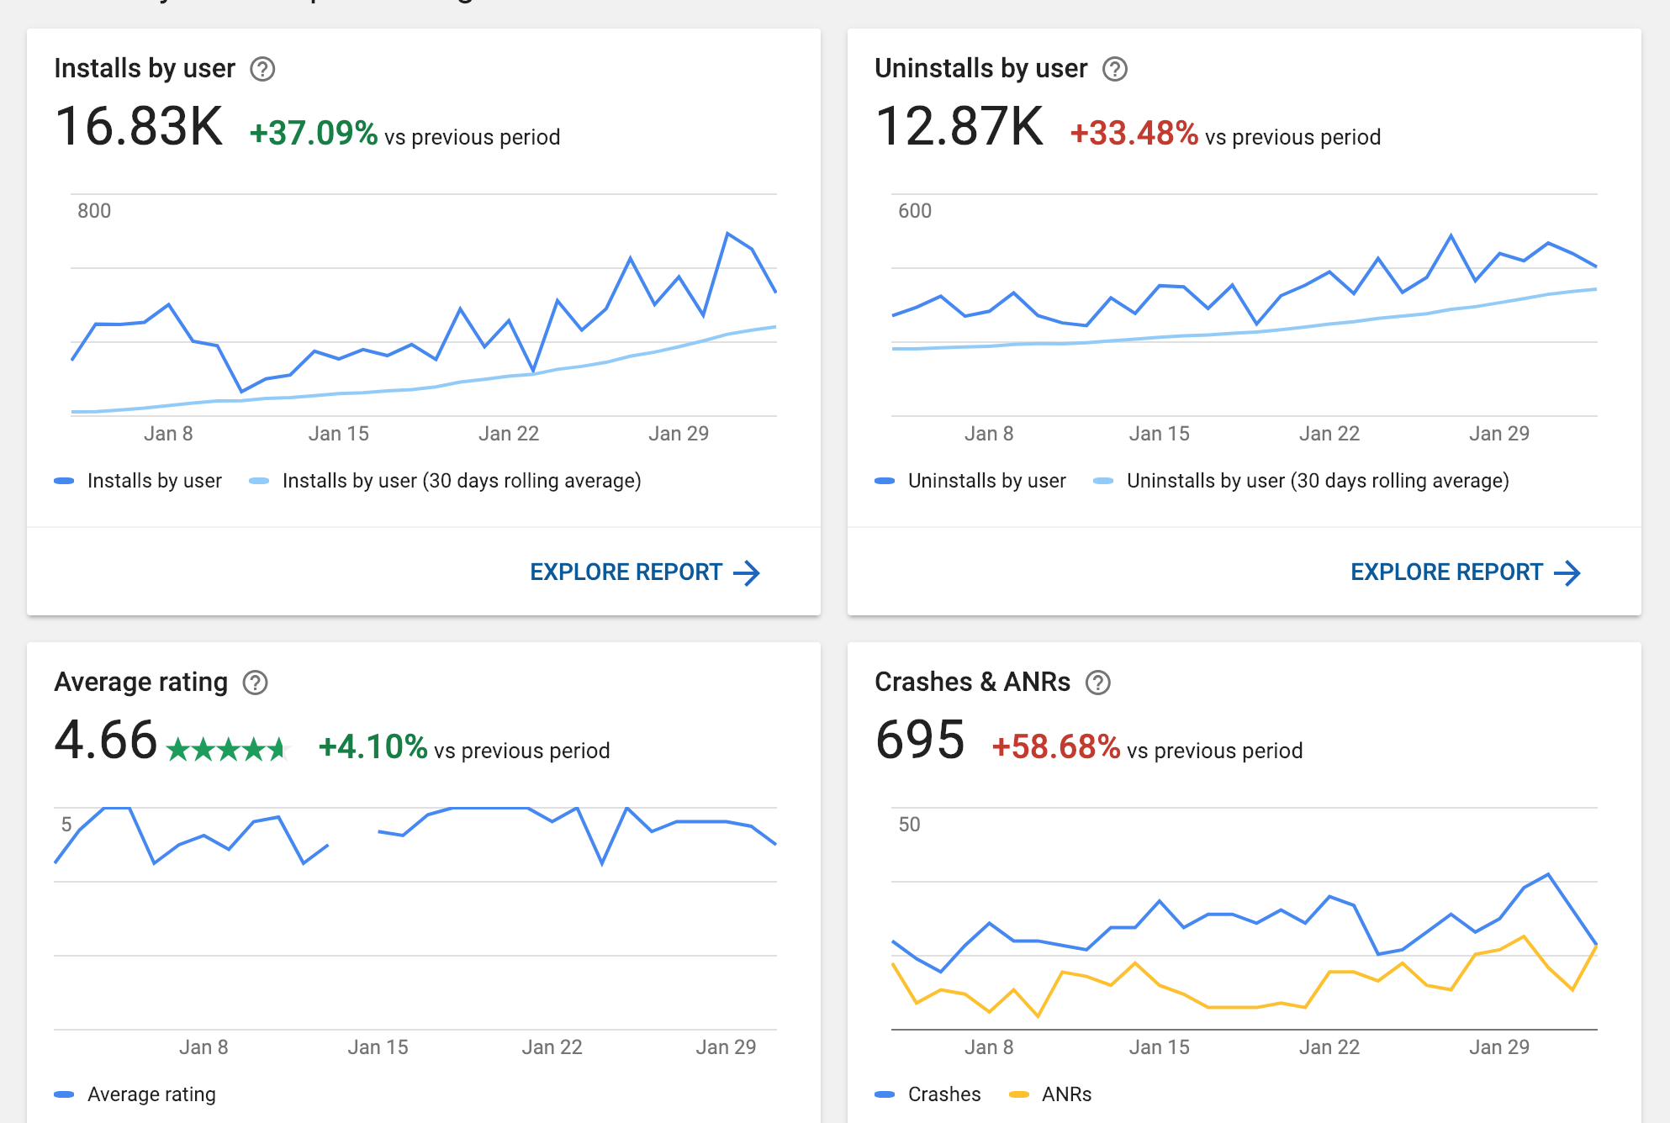

Slide 6
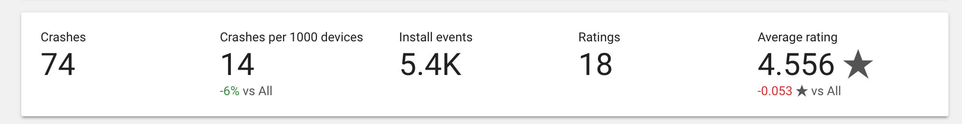
How was your last release

Slide 7
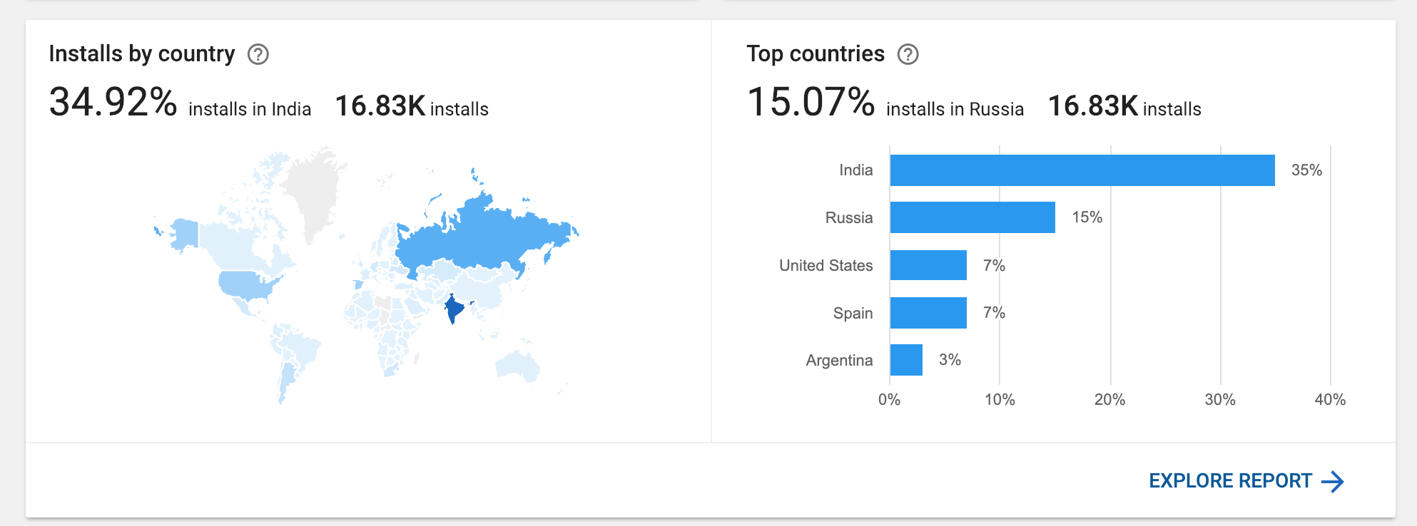
Installs by country

Slide 8
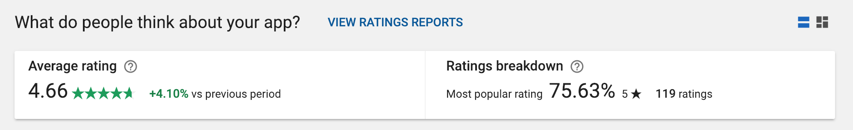
Rating

Slide 9
Examples
Firebase and fabric
Since mid 2019 fabric would merged into firebase

Slide 10
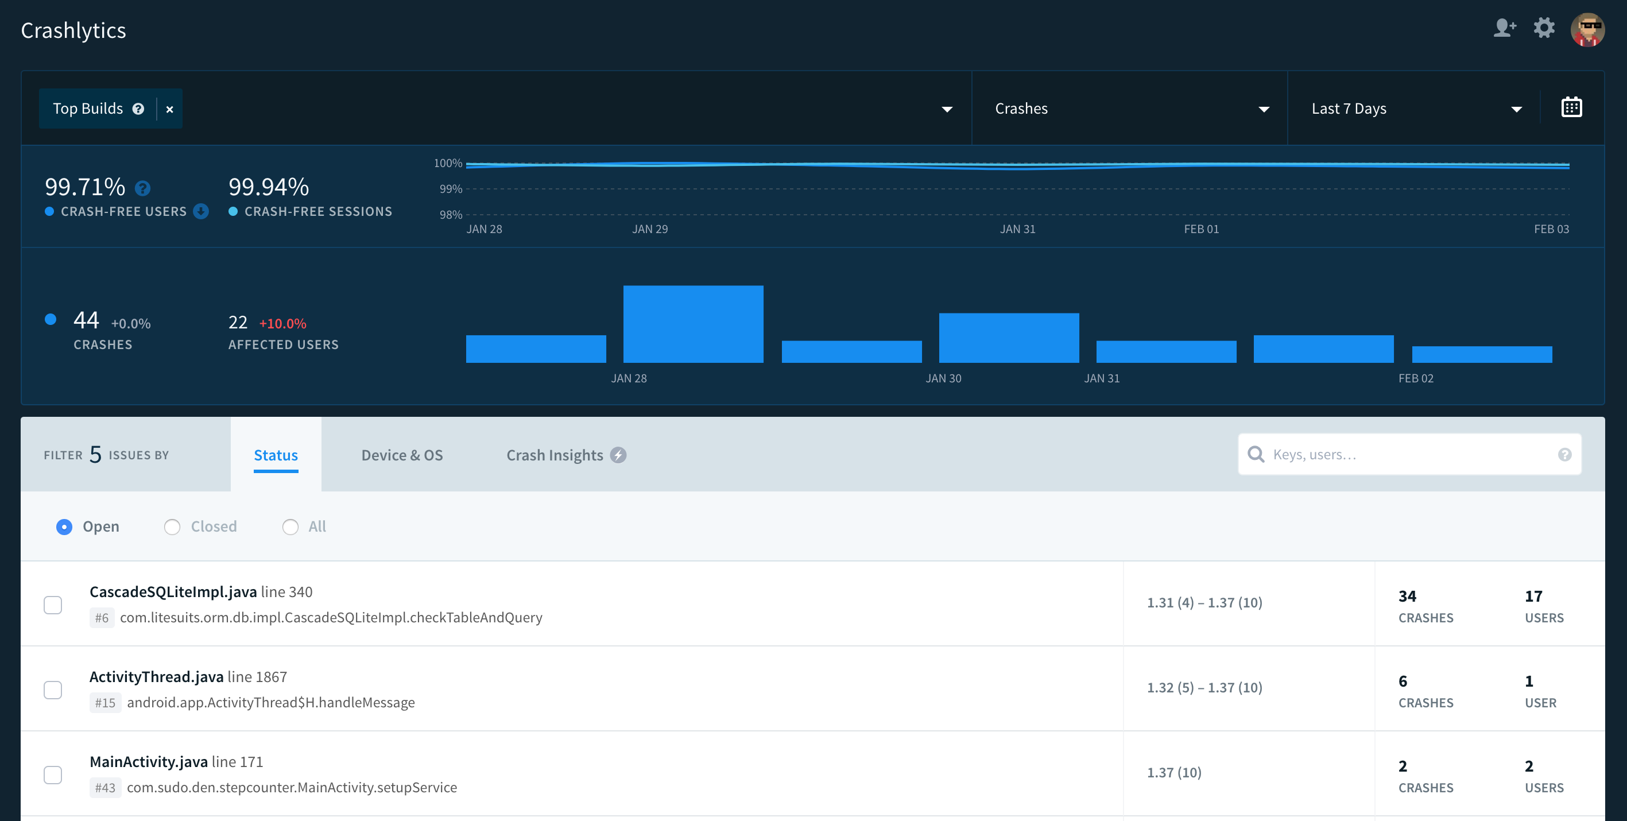
Crash reporting

Slide 11
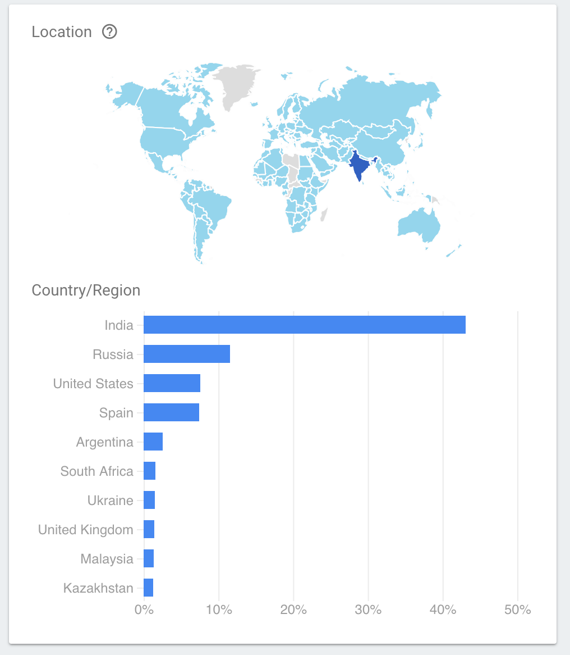
Users location

Slide 12
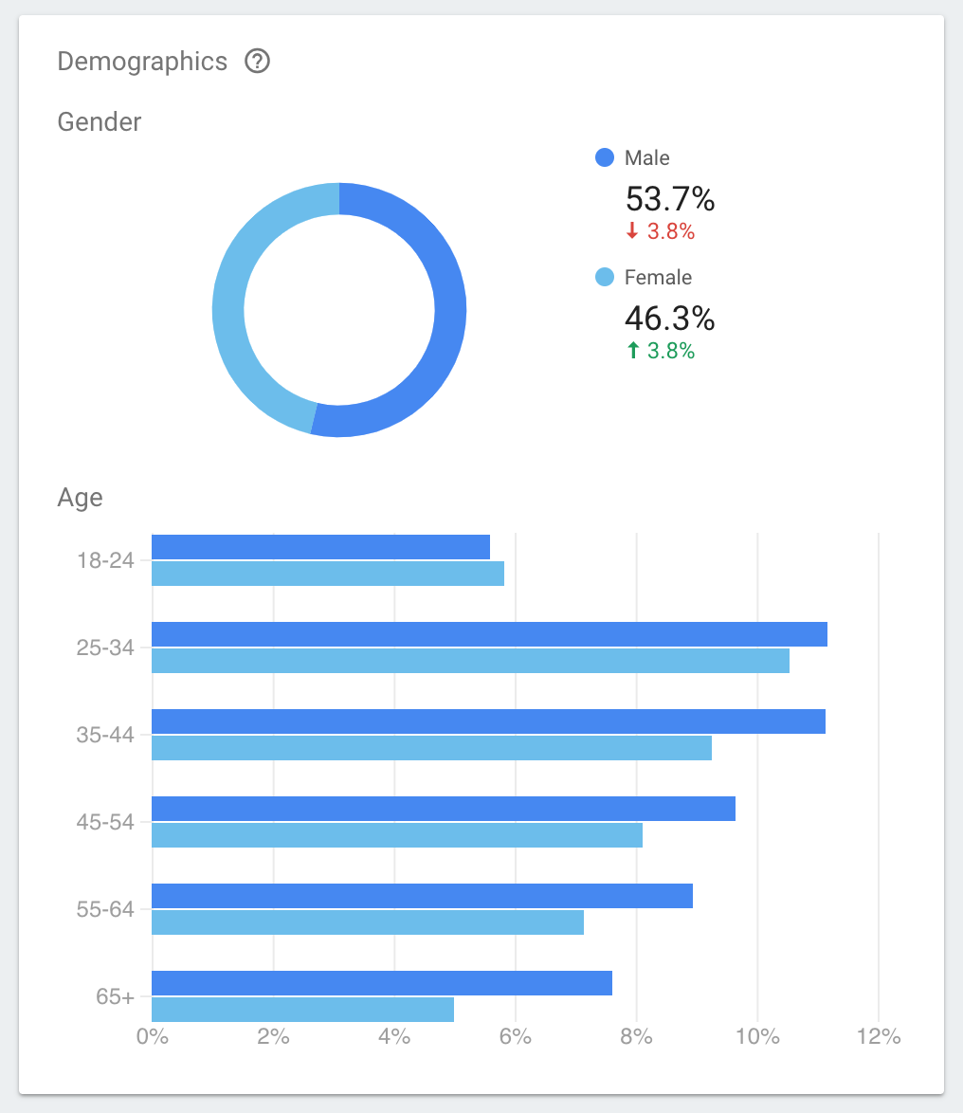
Users age and gender

Slide 13
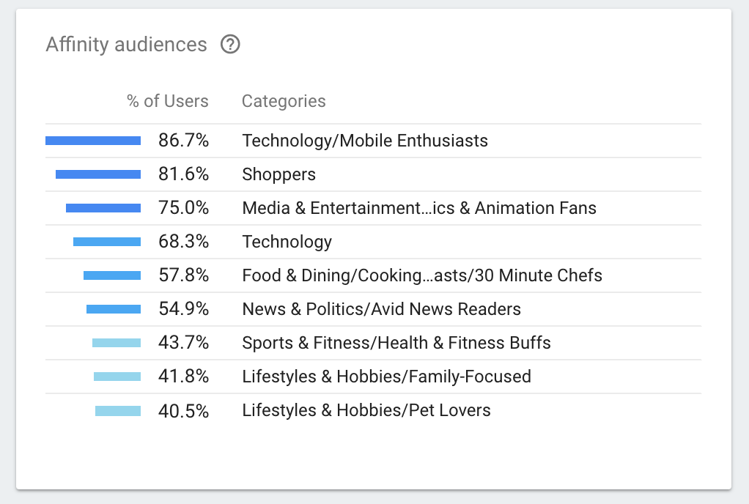
What is your user interest

Slide 14
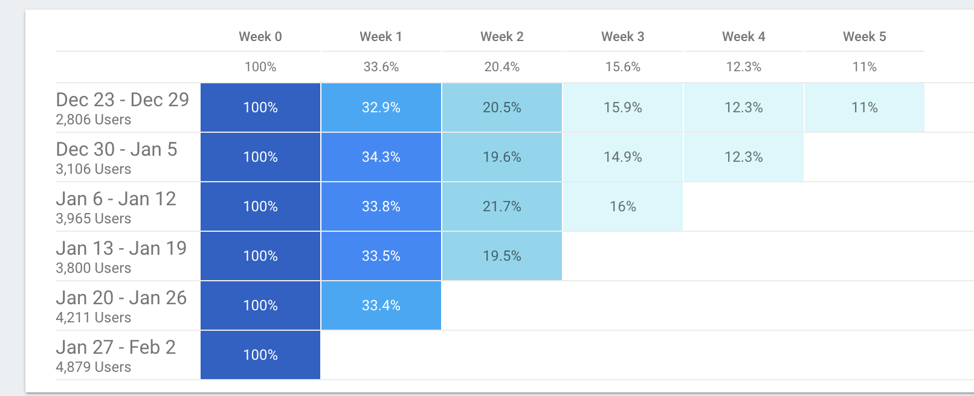
Retention

Slide 15
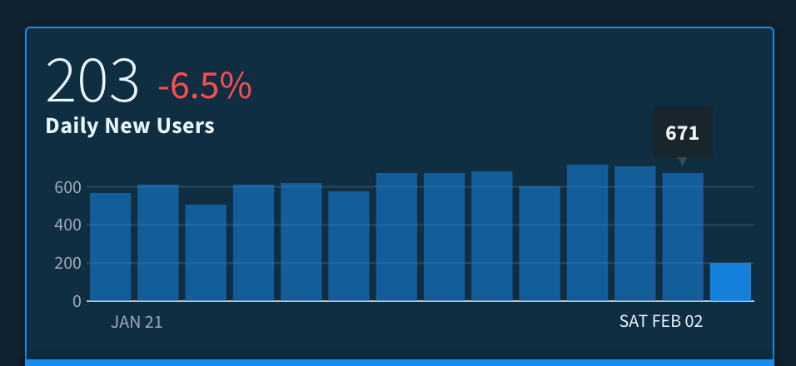
Daily new installs

Slide 16
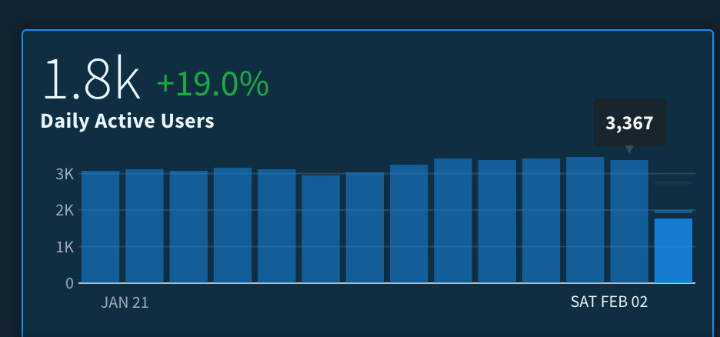
Daily active

Slide 17
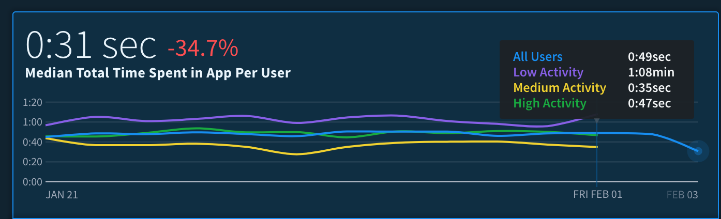
Time spend in app

Slide 18
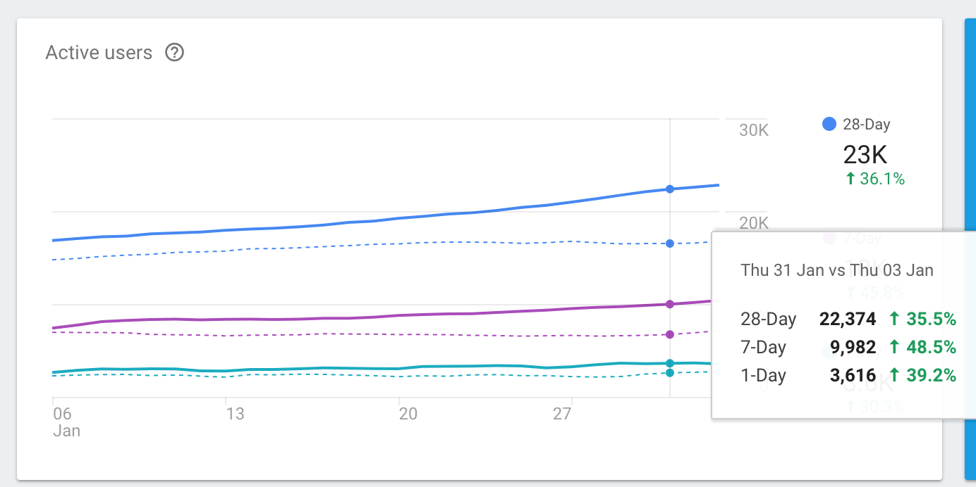
Compare with past data

Slide 19
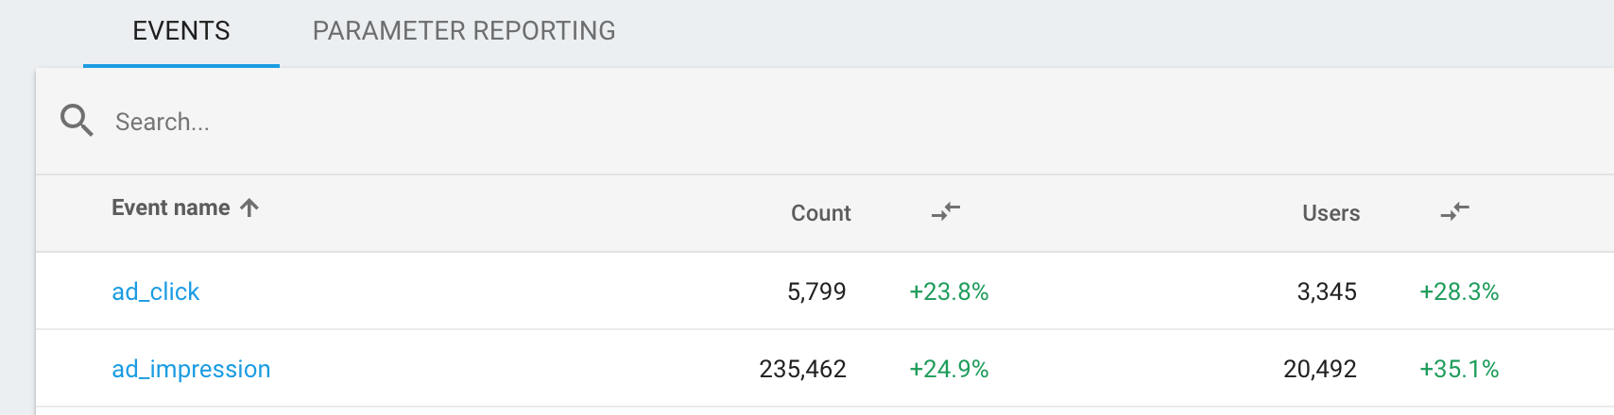
User actions

Slide 20
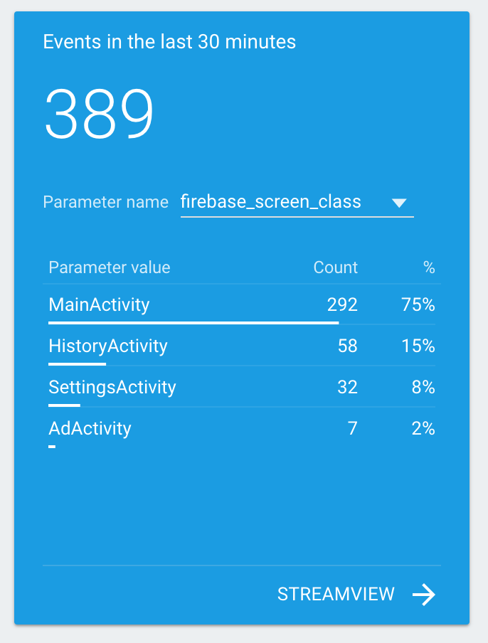
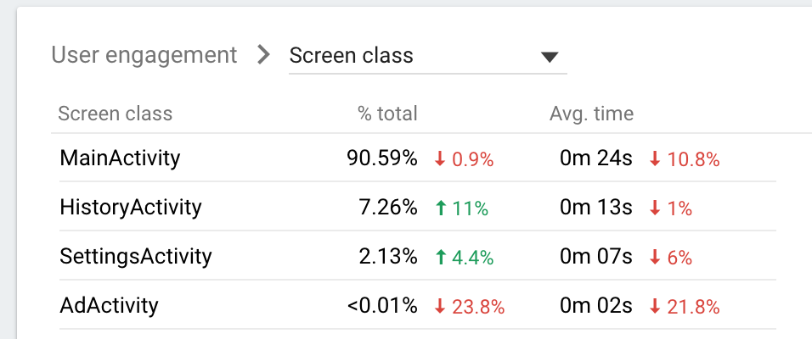
Screens time

Slide 21
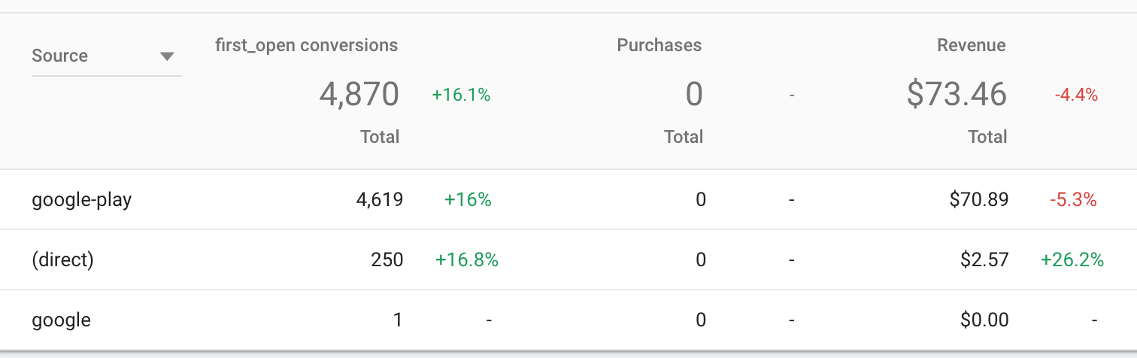
From where your users came and how much that years you

Slide 22
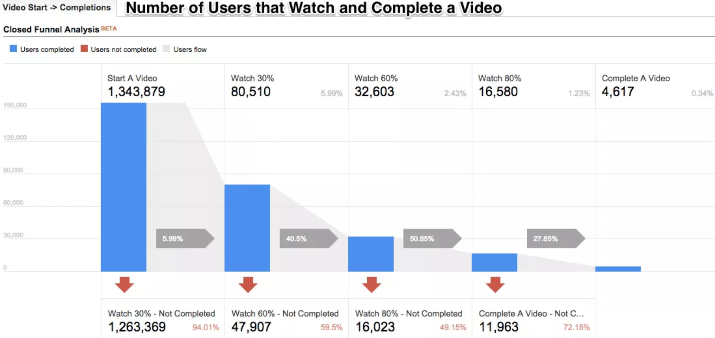
Funnels

Slide 23
Firebase integration tutorial
https://firebase.google.com/docs/android/setup

Slide 24
RecyclerView

Slide 25
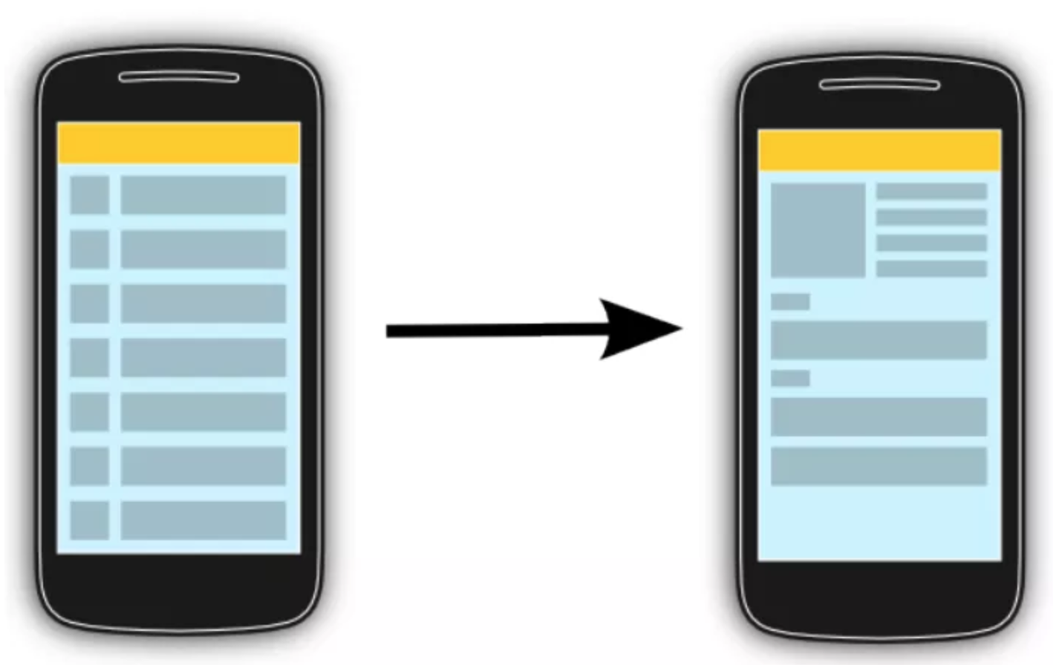
The RecyclerView class supports the display of a collection of data
It is a modernized version of the ListView and the GridView classes provided by the Android framework. Recycler view addresses several issues that the existing widgets have. It enforced a programming style that results in good performance. It also comes with default animations for removing and adding elements.

Slide 26
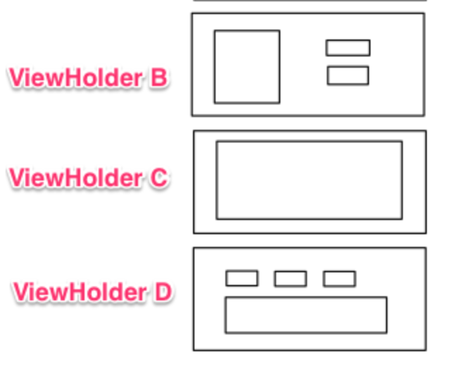
RecyclerView
RecyclerView allow to use different layout managers for positioning items.
Recycler view uses a ViewHolder to store references to the views for one entry in the recycler view. A ViewHolderclass is a static inner class in your adapter which holds references to the relevant views. With these references your code can avoid the time-consuming findViewById() method to update the widgets with new data.

Slide 27
Adapters
An adapter manages the data model and adapts it to the individual entries in the widget. It extends the RecyclerView.Adapter class and is assigned to the recycler view via the RecyclerView.setAdapter method. The input to the adapter of an recycler view can be any arbitrary Java objects. Based on this input the adapter must return the total number of items via its getItemCount() method.
The adapter prepares the layout of the items by inflating the correct layout for the individual data elements. This work is done in the onCreateViewHolder method. It returns an object of type ViewHolder per visual entry in the recycler view.
This instance is used to access the views in the inflated layout. The onCreateViewHolder method is only called then a new view must be created.
Every visible entry in a recycler view is filled with the correct data model item by the adapter. Once a data item becomes visible, the adapter assigns this data to the individual widgets which he inflated earlier. This work in done in the onBindViewHolder method.

Slide 28
Gradle dependency to use recycler view
The RecyclerView widget is delivered as library and can be used as of API 7 level or higher. Add the a dependency to the latest version of this library to your Gradle build file to use it.
implementation "com.android.support:recyclerview-v7:25.3.1"

Slide 29
Default layout manager
The layout manager decides how the data in the RecyclerView is displayed. The recycler view library provides the following build-in layout managers.
LinearLayoutManager shows items in a vertical or horizontal scrolling list.
GridLayoutManager shows items in a grid.
StaggeredGridLayoutManager shows items in a staggered grid.

Slide 30
More on recycle view
http://www.vogella.com/tutorials/AndroidRecyclerView/article.html

Slide 31
Homework
Add firebase to you app code (or Lesson 9)
Mark events:
Select Giphy
Select Unsplash
Select Favorites
Make a crash and see in in dashboard, in onCreate()
throw new RuntimeException("This is a crash");
RecycleView:
Implement on item press
Implement favorite button in recycle view

